Slide 1
Earned Income Credit (EIC)
Pub 4012 Tab I
Pub 17 Chapter 36
(Federal 1040-Line 66a)
(NJ 1040-Line 51a)
Notes:
1

Slide 2
EIC – General Eligibility Requirements
Pub 4012 Tab I
Must have earned income
Most common sources are:
Wages, salaries & tips
Disability benefits received prior to minimum company retirement age
Self-employment income
Household employee income
(full list in Pub 4012 Tab I)
Taxpayer & children must have SS #s valid for employment
Notes:
2
Some SS cards say “Not valid for employment.” The SS # may have been obtained to get a federally funded benefit

Slide 3
EIC – General Eligibility Requirements
Pub 4012 Tab I
(cont’d)
Not filing MFS
Citizen or resident alien all year
Investment income must be </= $3,400
Cannot be qualifying child of another person
Under specific AGI & earned income limitations(2015)
$47,747($53,267 MFJ)–3 or more qualifying children
$44,454($49,974 MFJ)-2 qualifying children
$39,131($44,651 MFJ)-1 qualifying child
$14,820($20,330 MFJ)-no qualifying child
Notes:
3

Slide 4
EIC – Additional Requirements With No Qualifying Child
Pub 4012 Tab I
At least 25 but under 65 as of 12/31
Cannot be the dependent or qualifying child of another person
Lived in US more than half the year
Notes:
4

Slide 5
EIC – Additional Requirements With Qualifying Child
Pub 4012 Tab I
Child meets qualifying relationship requirements
Child must have SS # valid for employment
Child under 19, OR under 24 & full-time student & younger than taxpayer, OR any age & permanently & totally disabled
Child did not file a joint return
Child lived with taxpayer over half the year
Child is unmarried BUT see Pub 17 for exceptions
Qualifying Child does NOT have to be a dependent
Notes:
5

Slide 6
EIC – Qualifying Child of More than One Person
Pub 4012 Tab I
If child meets conditions to be qualifying child of more than one person, only one person can claim child. Taxpayers can choose which person will claim the child
If multiple people claim same child, Tie-Breaker Rules applied for who can claim (in order):
Parent
Parent with whom child lived longest
Parent with highest AGI
If no one is the parent, person with highest AGI
NOTE: TaxAide counselor will never invoke Tie-Breaker Rules; that’s an IRS function
Notes:
6

Slide 7
How EIC Is Determined
Amount of EIC based on:
Filing status
Number of qualifying children (0, 1, 2, 3)
Higher of earned income or AGI
TaxSlayer determines EIC based on information entered in Filing Status, Personal Information, Dependent Information, and Income sections
Some additional data needed, so TaxSlayer inserts EIC Checklist in e-File section after return is completed. Answer questions not already populated
Notes:
7

Slide 8
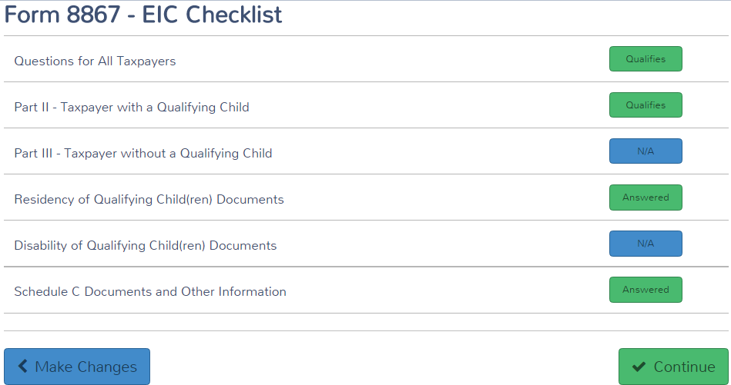
EIC Checklist – Form 8867 e-File Section \ EIC Checklist
Notes:
8

Slide 9
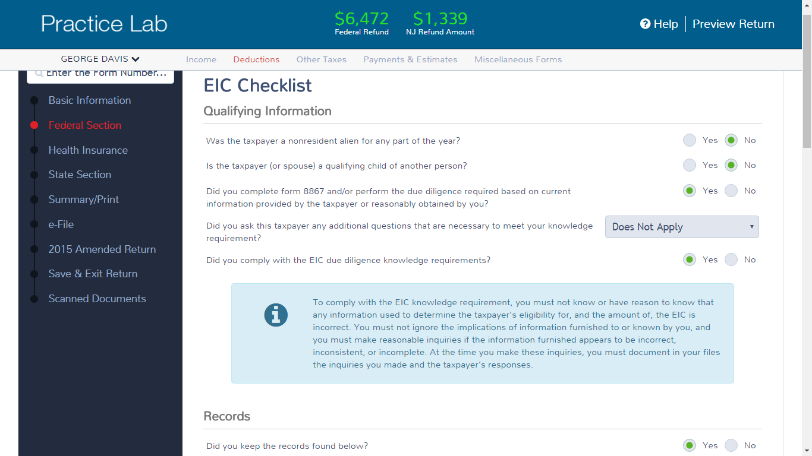
EIC Checklist – Questions for All Taxpayers – Form 8867 E-File Section \ EIC Checklist \ Questions for all Taxpayers
Answer questions not already populated;
some questions do not apply to TaxAide,
but must still be answered
Must be answered Yes
Notes:
9

Slide 10
Disallowed EIC
Form 8862 must be attached to return if prior year EIC claim was denied or reduced for any reason other than a math or clerical error
Enter in Federal Section \ Deductions \ Enter Myself \ Credits Menu \ Earned Income Credit (Form 8862)
If claim denied due to reckless or intentional disregard of EIC rules, cannot claim for 2 tax years
If fraud, cannot claim for 10 tax years
Notes:
10

Slide 11
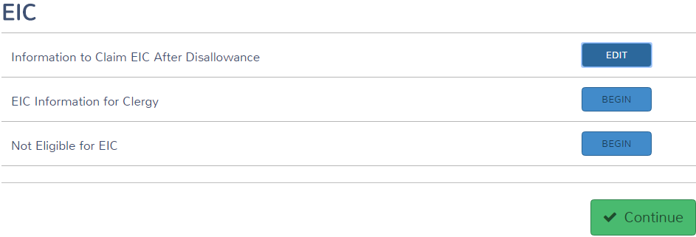
EIC After Disallowance Federal Section \ Deductions \ Enter Myself \ Credits Menu \ Earned Income Credit (Form 8862)
Notes:
11

Slide 12
EIC Amounts for 2015
Maximum EIC amounts for 2015
$6,242 with three or more qualifying children
$5,548 with two qualifying children
$3,359 with one qualifying child
$503 with no qualifying children
Notes:
12
This is just to give you an idea of the EIC amounts for 2015. TS automatically calculates this credit

Slide 13
Other Considerations
For EIC, support is not an issue
Under rules for divorced/separated parents, only custodial parent qualifies for EIC, no matter who claims dependent
If a nondependent can be claimed as a qualifying child for EIC:
Name of nondependent will not be listed in Exemption section of Federal 1040, but will be listed on Schedule EIC
Name of nondependent will be listed in Dependent section of NJ 1040, followed by (EIC ONLY)
Needed for NJ to verify amount of NJ Earned Income Tax Credit
Notes:
03Filing Status 2008x
13
In TaxWise, we had to manually enter a nondependent who is eligible for NJ EITC using override capability. TaxSlayer automatically lists the nondependent in the Dependent section of the NJ 1040, followed by the words “EIC ONLY”
This helps NJ know how many qualifying children there are for EITC. They can then verify the correct EITC amount

Slide 14
TS – Nondependent Who Is Qualified Child For Earned Income Credit – 1040 Exemption Section
Does not include name of second child who is a nondependent, but is
a qualified child for Earned Income Credit
Notes:
14

Slide 15
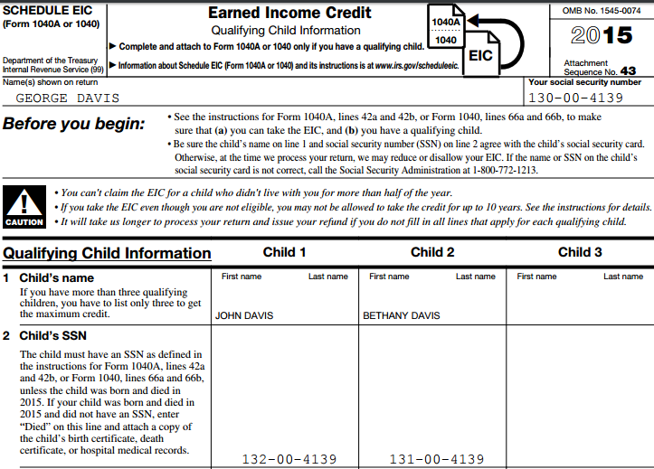
TS – Nondependent Who Is Qualified Child For Earned Income Credit – Schedule EIC
Includes name of second child who is a nondependent, but is
a qualified child for Earned Income Credit
Notes:
15

Slide 16
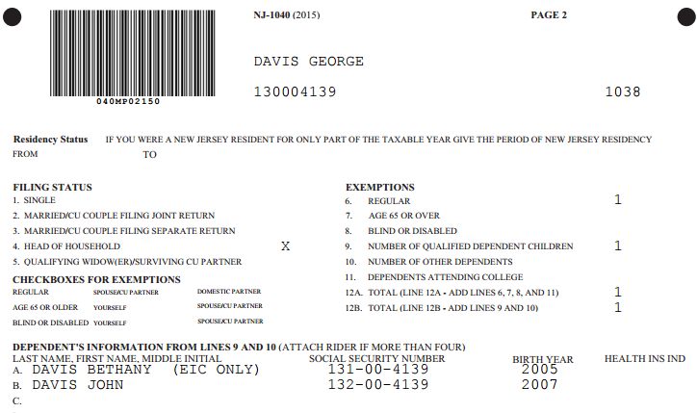
TS – Nondependent Who Is Qualified Child For Earned Income Credit – NJ 1040 Dependent Section
For a nondependent who is a qualified child for Earned Income Credit,
NJ Dependent Section shows name of child followed by ”(EIC ONLY)”
Notes:
16

Slide 17
NJ Earned Income Tax Credit (EITC)
Residents who are eligible & file for Federal EIC may also apply for a NJ EITC
Client may have Federal earned income, but no NJ earned income (e.g. – disability, third-party sick pay). Still eligible for NJ EITC
NJ EITC = 30% of Federal EIC
TaxSlayer calculates automatically on NJ 1040 Line 51a
Before issuing refund checks, NJ checking EITC claims carefully to reduce fraud
IRS also checks for fraud, but takes a while. NJ does not want to issue refunds and then have to recover money

Slide 18
NJ Earned Income Tax Credit (EITC) Fraud Detection Measures
NJ checks EITC claims carefully. Frequently sends out requests for additional info
Federal tax account transcript – includes original Federal return, amended return, other IRS letters
SS cards for taxpayer and dependents - to track across years and geography
Birth certificate/guardianship documents for kids
May definitely delay refunds
Also sends out requests to explain differences between Federal and NJ pension amounts
Military pensions, 3-year rule, etc.

Slide 19
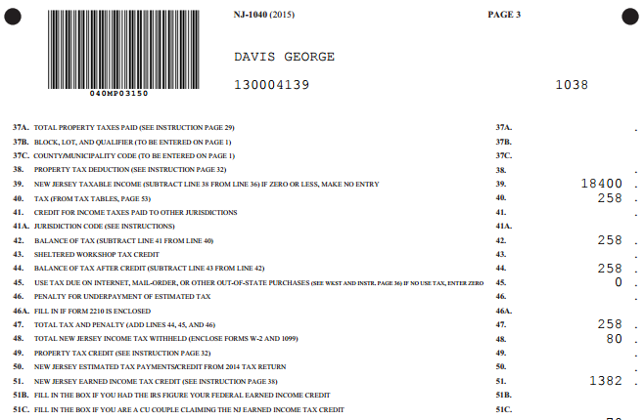
TS – Earned Income Tax Credit - NJ 1040 Line 51
Notes:
19

